Slide 1


CITS1003 Introduction to Cybersecurity [0] Unit overview
Dr Zhi Zhang

Slide 2

Prior to Joining UWA
Ph.D. at UNSW
Research Scientist in Cyber Security at CSIRO, Data61
Research Interests
Operating System Security, Virtualization Security, Cryptographic Analysis and Adversarial ML
Email: zhi.zhang@uwa.edu.au (queries related to CITS1003: cits1003-pmc@uwa.edu.au)
https://zhangzhics.github.io

Slide 3
White Hat Assessment…
Reported 2 vulnerabilities to cloud vendors, i.e., Xen and Docker.
Developed 2 patches to Xen, which have been merged to its mainline.
Recently reported 3 vulnerabilities to cryptographic toolkits, i.e., WolfSSL and Relic.
Presented interesting hacking techniques at famous hacking conferences

Slide 4
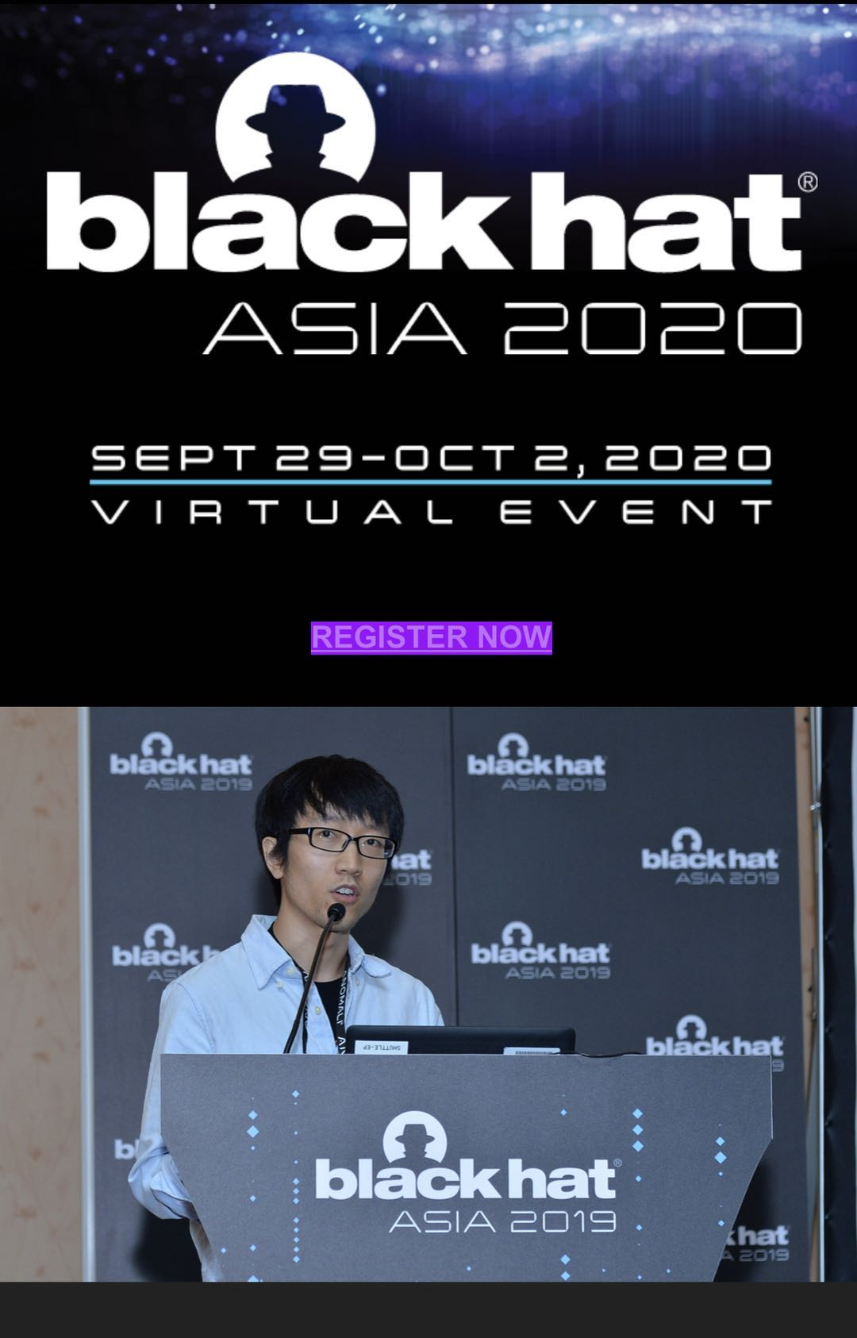

Slide 5

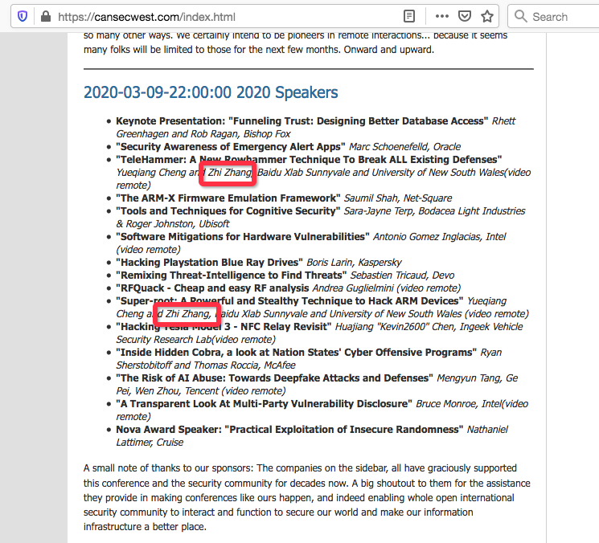
2020

Slide 6
3 Things
Understand the objectives and structure of this unit
01
Understand the technical requirements and role of the practical component
02
Understand the “rules” or ethics of cybersecurity and this unit
03

Slide 7
Pre-Requisites and Target Audience
There are hundreds of students enrolled (more than 750 atm) in the unit from diverse backgrounds
There will be minimal coding (unless you want to do more) in this unit and no assumption of prior knowledge in computer science
This is an introductory course and should be suitable for anyone wishing to familiarise themselves with the terms, concepts and practical aspects of Cybersecurity
The course is mainly based on CyBOK - the Cybersecurity Book of Knowledge project (https://www.cybok.org/)

Slide 8
To Get Started
People
Emergency
Items of assessment
Topics
Ethics
Online resources
FAQs
What is Cybersecurity?
Learning outcomes

Slide 9


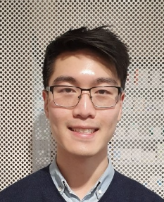
People
Aliah Al-shabib
Lab facilitator
Pascal Sun
Lab facilitator
Wenxiao Zhang
Lab facilitator
Hass
School operations team
Room: Main reception
schoolops-pmc@uwa.edu.au
Zhi Zhang
Unit coordinator
Room G.10
cits1003-pmc@uwa.edu.au
Larry Huynh
Assistant Lecturer
Brian Chan
Lab facilitator
Jack Sun
Lab facilitator
Davis Huang
Lab facilitator
Henuka Daluwatta
Lab facilitator
Huixin Yang
Lab facilitator
Long Qin
Lab facilitator

Slide 10
Emergency
General emergency: call campus security at 6488 2222
In super emergency: call emergency at 000
For more details, please have a read through our emergency procedure for various potential incidents
http://www.safety.uwa.edu.au/incidents-injuries-emergency/procedures
For more student services:
https://www.uwa.edu.au/students/Support-services
UniAccess: https://www.uwa.edu.au/students/Support-services/Disability-and-accessibility (send me your Uniaccess letters :>)

Slide 11
Assessments
Lectures
Labs
Project
Final Exam

Slide 12
Lectures
Lectures are presented in a flipped style: watch pre-recorded video lectures of one topic before coming to live lectures.
For video lectures, they are online (all 12 weeks worth of lectures!)
For live lectures, they will be recorded and uploaded into LMS.
We focus on interactive exercises and discussions with final exam-style questions included.
Live lectures last around 60-90 mins.

Slide 13
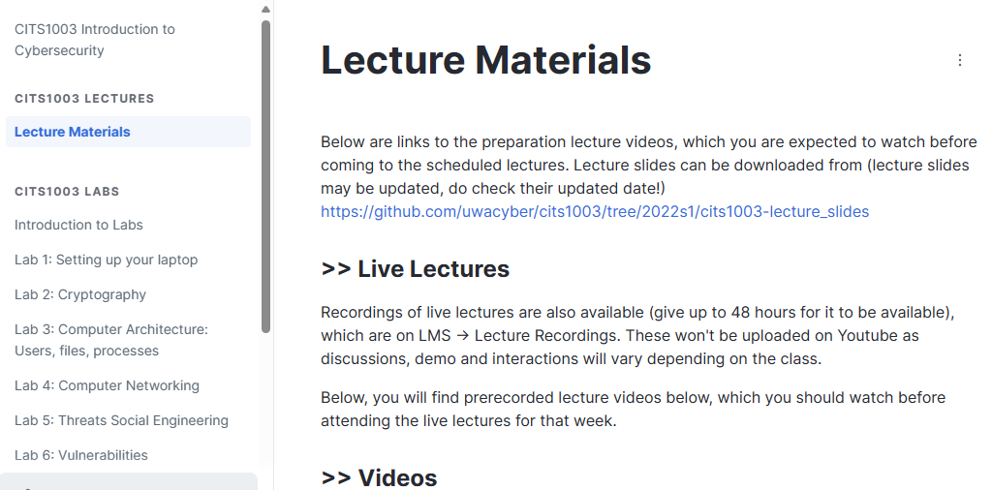
https://uwacyber.gitbook.io/cits1003/cits1003-lectures/lecture-materials

Slide 14
Labs start in week 1
Lab materials
Lab location
Lab computer
Lab assessment
Lab help
Lab due dates
Lab setup

Slide 15
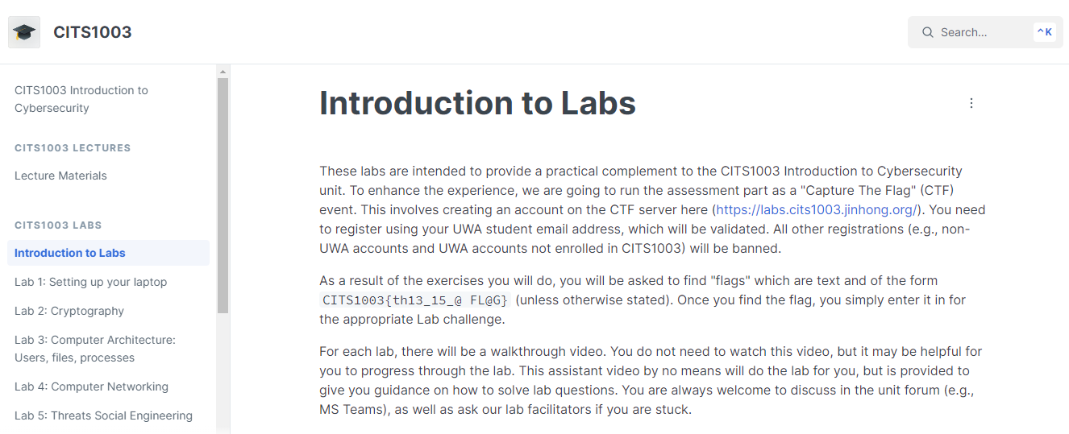
https://uwacyber.gitbook.io/cits1003/cits1003-labs/introduction-to-labs

Slide 16
Lab Location
Labs
Check your timetable for your lab allocation (https://studentvip.com.au/uwa/main/maps)
You may go to another scheduled lab IF there is a space (normally there is)

Slide 17
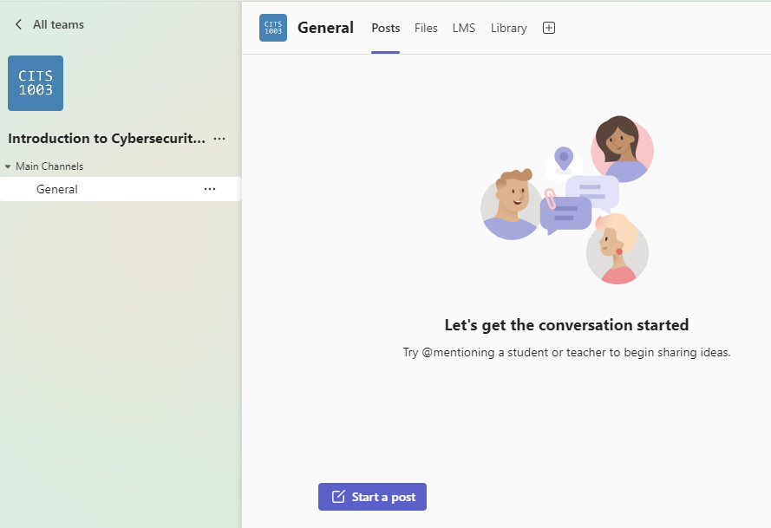
MS Teams

Slide 18
Lab Computer
The labs are related to docker, VirtualBox/VMware/UTM, Ubuntu OS, etc
As these virtualization software are NOT available on UWA lab machines, they must be run on your laptops
If you do not have a laptop that is capable of running the labs, you can arrange to borrow one: https://uwacyber.gitbook.io/cits1003/cits1003-labs/introduction-to-labs
Else – invest in a decent laptop – it will make a big difference to your University life.
If none of these options are available to you, please come and chat with me.

Slide 19
Lab Assessment
Labs are worth 25% of the final grade.
Each lab is worth 25 points
10 labs in total are worth 250 points.
Submission site: https://labs.cits1003.jinhong.org/

Slide 20
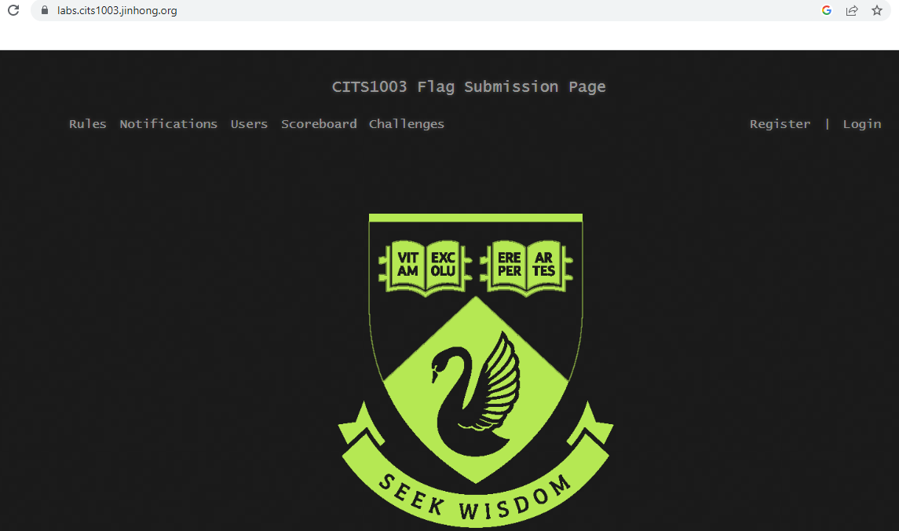
Submission Site

Slide 21
Lab Help
For labs, we will be using a help server, which allows students to queue for help
This means no fighting over who put their hands up first
Online students can get noticed
No lab help outside the scheduled lab time

Slide 22
A Help Server
Access the help server at: https://help.jinhong.org/
By default, you use your student ID with temporary password “helloworld”
Any issues logging in, contact any of the facilitators or me
Fill out a form and wait until a facilitator comes to you
If you are doing labs via online, then facilitators will contact you via Teams.
Online is discouraged, as troubleshooting is much harder compared to F2F

Slide 23
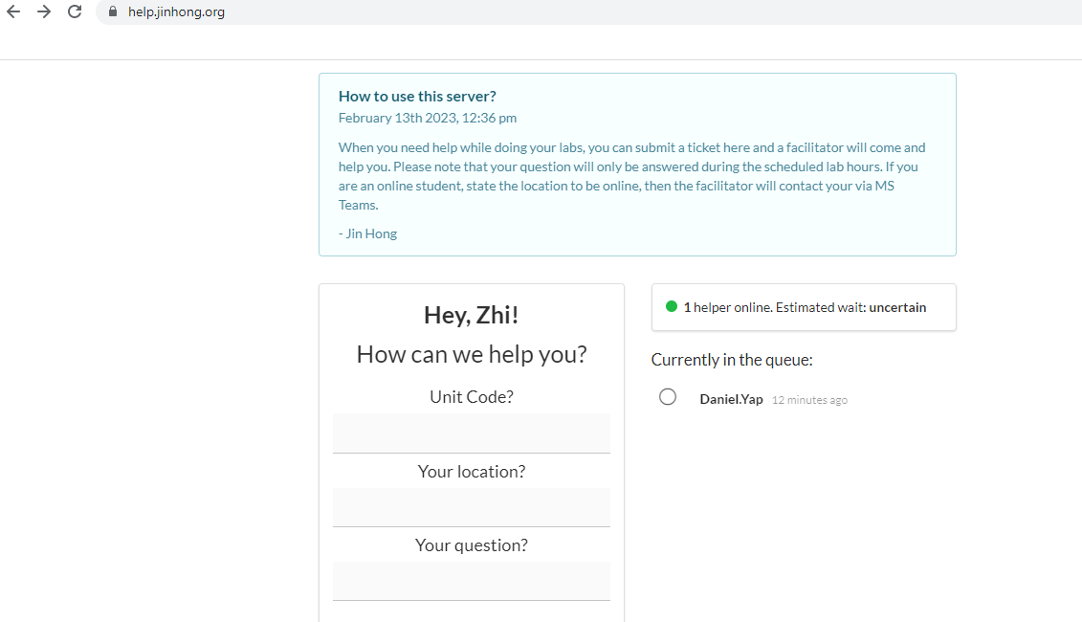
https://help.jinhong.org

Slide 24
Lab Due Dates
For labs 1-3, due date: 5pm 22 March
For labs 4-6, due date: 5pm 19 April
For labs 7-10, due date: 5pm 17 May

Slide 25
Lab Setup
Virtual Machine Manager: Virtualbox, VMware or UTM
Setup VM and do labs there to avoid any mistakes propagating to your host
VM provides an additional layer of security.

Slide 26
Other Assessments
Project will be released in Week 6 (tentative) and end in Week 11 (tentative). This will be similar in format to the labs – except without the guidance part
Project is worth 25% of final grade
Final Exam: 50% of final grade
Exam overview will be done in week 12.
Exam can be assisted by open-book notes without electronic materials

Slide 27
Weekly Topics
Introduction to overall definitions and concepts of cyber security
Cryptography: codes and ciphers
Computers and Networks
Threats
Vulnerabilities
Security management
Incidents
Forensics
Critical Infrastructure and Cyber Physical Systems
Cyber Law
AI and Cybersecurity

Slide 28
Enquiries
Office hours
Maybe Friday 12 – 2pm (F2F and virtual ) -> this is just an arbitrary slot
Other times can be arranged too (email us through cits1003-pmc@uwa.edu.au)
Lab Enquiries
Ask on Teams (but remember not to share answers)
Ask from the help server during the lab session
If all fails, email us

Slide 29
Online Resources
You may find David's book on Ethical Hacking with Hack The Box useful
https://2772132586-files.gitbook.io/~/files/v0/b/gitbook-legacy-files/o/assets%2F-M8JUFT2qjA1kHV7SeEI%2F-MbKnPR4PgdotRQvCM-D%2F-MbKqReUfLRQ5bE-3gR3%2FEthicalHackingHTBDGv1.pdf?alt=media&token=6a805194-ead2-44d1-aaa3-98fa03084b91
Other useful online resources will be provided throughout the weeks as necessary.
ChatGPT might be more useful than traditional search engines.

Slide 30
FAQs
Q: Why do labs take too long to finish?
A:
Labs are to get you familiar with various cybersecurity concepts, and it could take longer than the allocated 2 hours for the lab to finish it.
You are welcome to attend other scheduled labs (given there are spaces for extra students) to complete the labs with the help of lab facilitators.

Slide 31
FAQs
Q: Why don’t we get sample answers for labs?
A:
The lab solutions for this unit can be different significantly from one to another, even with reasonably simple questions.
We simply don’t want you to learn sample answers, but rather learn to explore various ways of solving (i.e., improve problem solving skills).
We (facilitators and lecturers) are happy to discuss your solution, work out what might be going wrong and try to fix it with you.

Slide 32

Cheating
Please don’t cheat on any of the assessment items.
Don’t copy your friend’s code.
Don’t copy code from online.
Don’t share your code structure with your friends
Only share ideas
Consequences are dire!

Slide 33
Information Security
All human endeavour relies on information
Business, Government, Education, Research, Personal life
Information security is about protecting this information from “unauthorised access, harm or misuse”¹
This is done by preserving Confidentiality, Integrity and Availability of information

Slide 34
What is Cybersecurity?
Cybersecurity is a subset of Information Security that concerns the digital realm:
It refers to the protection of information systems (hardware, software and associated infrastructure), the data on them, and the services they provide, from unauthorised access, harm or misuse. This includes harm caused intentionally by the operator of the system, or accidentally, as a result of failing to follow security procedures.
CIA is sometimes extended to include Authentication, Accountability, Non-Repudiation and Reliability

Slide 35
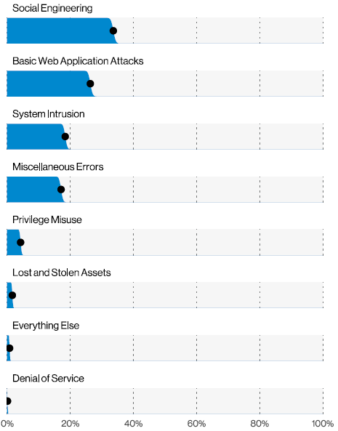
Human Exploits
2021 breaches

Slide 36
Learning Outcomes
To understand and be able to articulate
The language of Cybersecurity
The principles of preserving Confidentiality, Integrity and Availability
Principles of Risk Management
Cybersecurity in the domains of
* Human organisational and regulatory aspects, * Attacks and Defences, * System Security, * Software and Platform Security, * Infrastructure Security
Case studies will be used to illustrate and concretise language, terms and concepts throughout the live lectures
Practical laboratory work will assist in practical aspects of Cybersecurity

Slide 37
Ethics (or what you *absolutely* should not do)
Codes of Ethics are needed by all endeavours that are professions. In cybersecurity, there are several organisations that have them
ISC²
Protect society, the common good, necessary public trust and confidence, and the infrastructure.
Act honourably, honestly, justly, responsibly, and legally.
Provide diligent and competent service to principals.
Advance and protect the profession.

Slide 38
Ethics continued…
Don’t do anything that you don’t have explicit authorisation to do
Hacking without authorization is a crime in almost every country
You can cause damage to yourself and others by being negligent
A safe environment enables you to explore, investigate and learn

Slide 39
Copyright notice
Commonwealth of Australia
Copyright Regulations 1969
WARNING
Materials in this unit (CITS1003 – Introduction to Cybersecurity) have been reproduced and communicated to you by or on behalf of The University of Western Australia pursuant to Part VB of the Copyright Act1968 (the Act).
The material in this communication may be subject to copyright under the Act. Any further reproduction or communication of this material by you may be the subject of copyright protection under the Act.

